Slide 1
DNS
Server
IP주소
URL
Web
brower
HTTP Request
DNS
Resolver
HTTP Request

Slide 2
DNS
Server
IP주소
URL
Web
brower
HTTP Request
DNS
Resolver
HTTP Request
Protocol
Stack
HTTP Request

Slide 3


The Nearest
DNS Server
Root Domain
DNS Server
com
DNS Server
naver
DNS Server
www
DNS Server
$$⋮$$
IP주소
www.naver.com
Client
HTTP Request

Slide 4
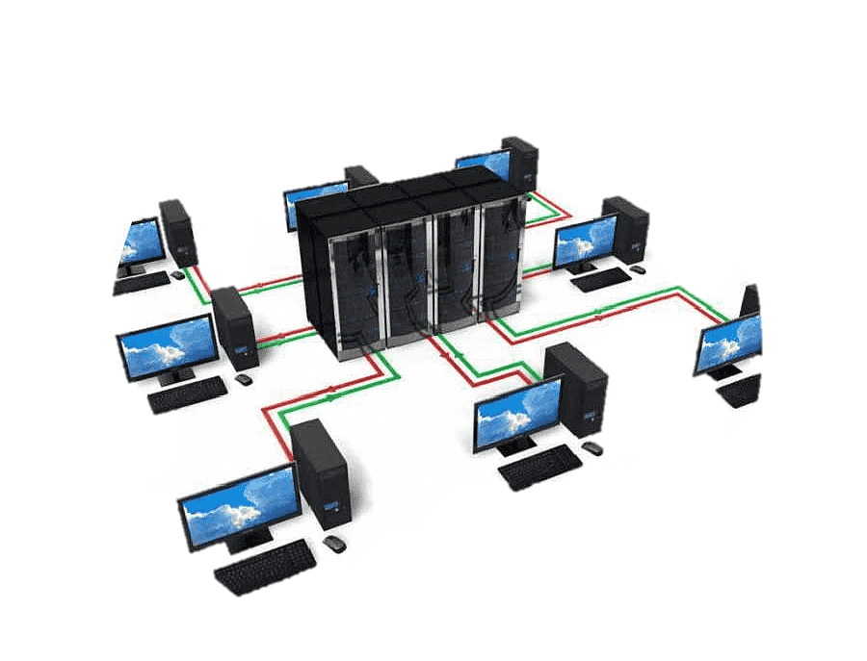
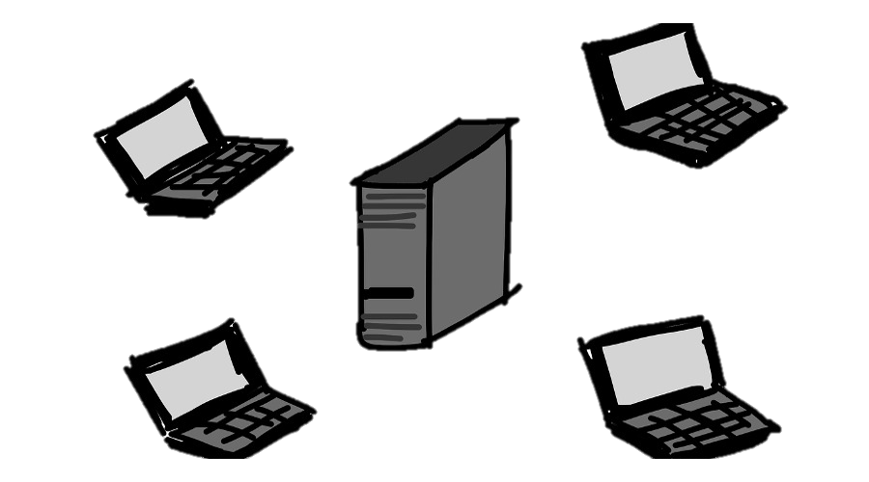

Slide 5


Slide 6





3번
4번
HUB
2번
5번
1번

Slide 7

. . .
. . .
. . .
. . .
. . .
. . .
HUB
HUB
. . .
. . .
. . .
. . .
. . .
: 콜리전 도메인

Slide 8
HUB
SWITCH
HUB
: 콜리전 도메인

Slide 9
MAC Address Table
HUB
SWITCH
HUB
: 콜리전 도메인

Slide 10
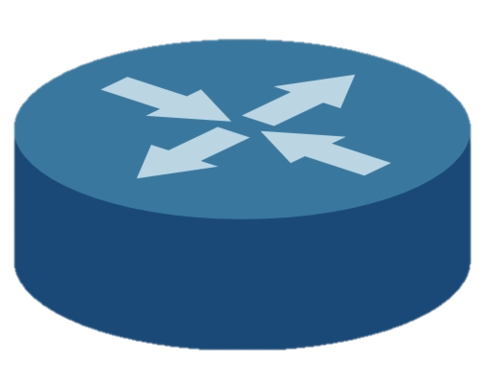
ROUTER
SWITCH
SWITCH
: 콜리전 도메인
: 브로드캐스트 도메인

Slide 11
progress
check
order
modify
cancel
URL의 역할
HTTP 메소드의 역할

Slide 12
progress
(POST)
check
(GET)
order
modify
(PUT, PATCH)
cancel
(DELETE)
URL의 역할
HTTP 메소드의 역할

Slide 13


ftp
ssh
http
Application(Web Browser)
socket
Lower Application(OS)
TCP
UDP
Transport
IP
Network
$$⋮$$

Slide 14
Topic 1
Consumer Group
Partition 0
Partition 1
Consumer 1
Partition 2
Consumer 2
Topic 2
Partition 0
Partition 1
Consumer 2
Partition 2

Slide 16
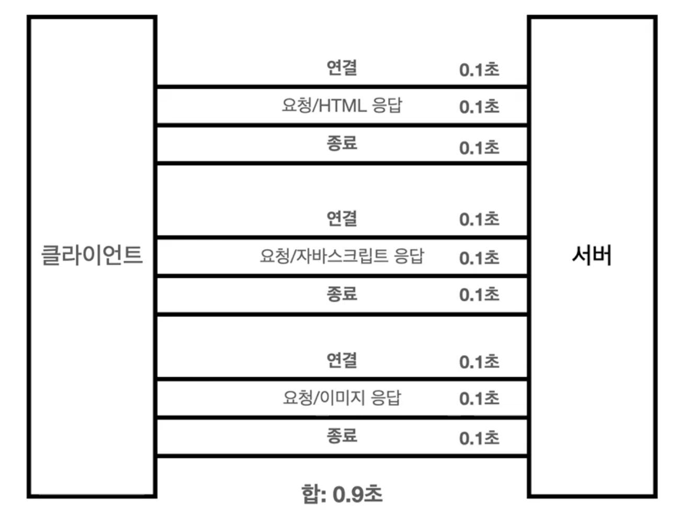
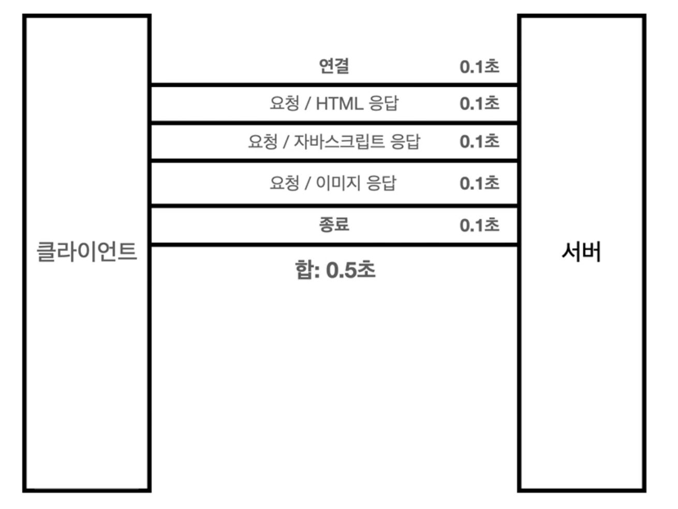
HTTP 초기
HTTP 지속 연결

Slide 17

Client 상태
Server 상태
Closed
Closed
Listen
SYN sent
SYN
SYN+ACK
SYN received
Established
ACK
Established

Slide 18
MAC Address Table
IP Address Table
ROUTER
SWITCH
SWITCH
: 콜리전 도메인
: 브로드캐스트 도메인

Slide 19
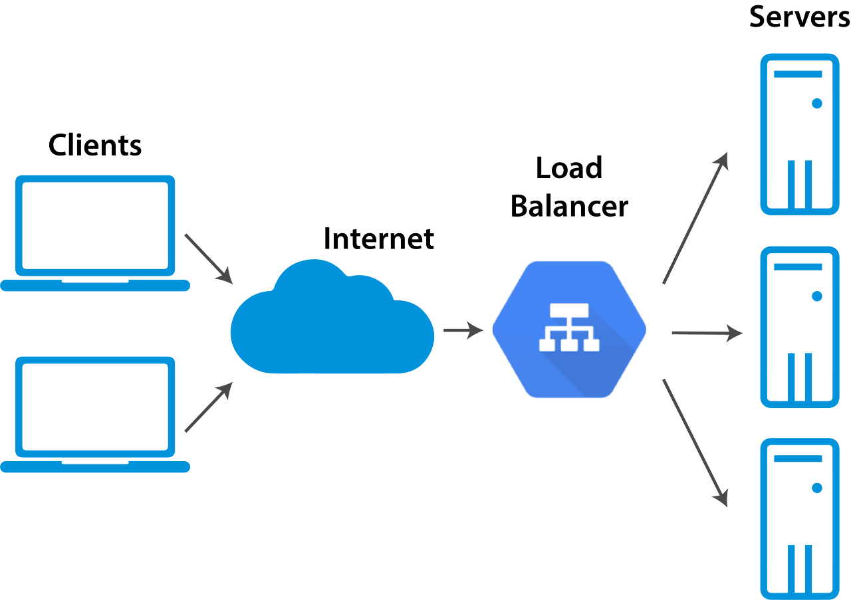
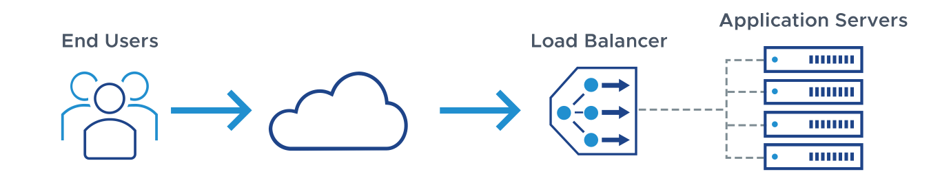

Slide 20
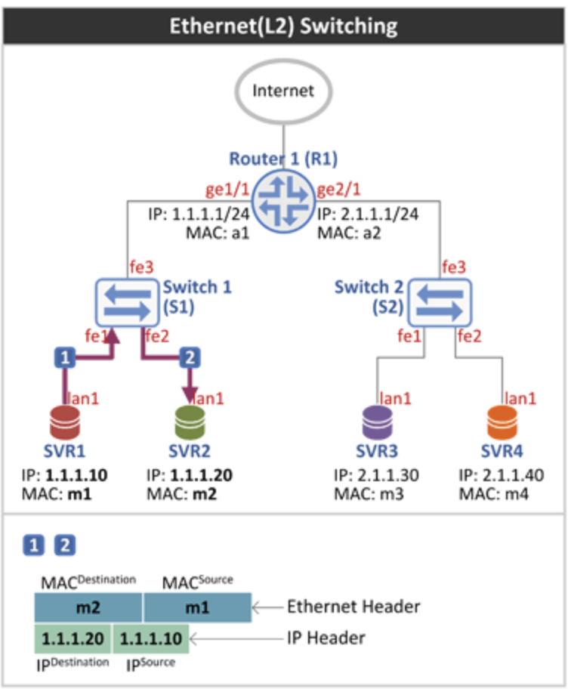

Slide 21
